Slide 1
AGENTIC AI, GIS & DIGITAL TWIN
Aqua Genesis
Autonomous flood mitigation via real-time hydrologic digital twins.
github.com/tmthangaraj1980-AIML/Aqua_Genesis_project

Slide 2

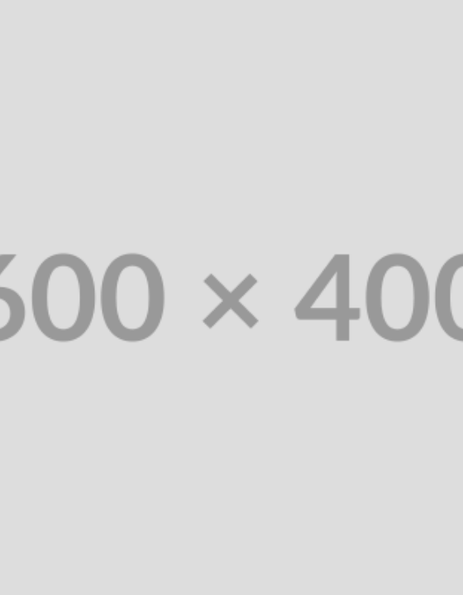
THE PROBLEM
Reactive Hydrology
Delayed Response: Manual gate control during flash floods is too slow.
Static Mapping: Historical flood maps fail in dynamic storm events.
Complex Physics: Non-linear water flow exceeds human predictive capacity.

Slide 3



System Objectives
GIS Integration
Digital Twin
Agentic Control
Injest high-resolution DEM and live sensor streams.
Real-time fluid dynamic simulation of urban topology.
Autonomous RL agents recommending mitigation acts.

Slide 4






Technology Stack
Python
RLlib
QGIS / GDAL
Hydro-Engine
IoT MQTT
Docker

Slide 5
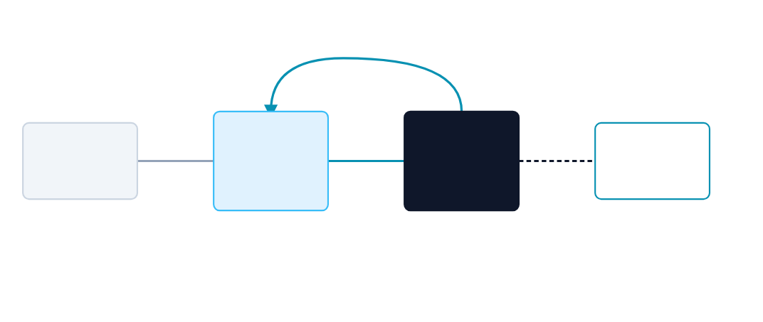
Twin & Agent Architecture
State Observation
IoT / Weather
Telemetry
Actuators / UI
Dashboard
Digital Twin
RL Agent
(GIS Environment)
(Action Policy)

Slide 6




Autonomous Loop
1. Sense
2. Synchronize
3. Decide
4. Actuate
Ingest IoT river gauges.
Update 3D Twin state.
Agent selects gate actions.
Dispatch hardware command.

Slide 7
Data Foundations
Spatial & Temporal Data
Environment Preprocessing
High-Res DEM (Digital Elevation).
Spatial interpolation of missing telemetry.
Live rainfall intensity APIs.
Resolution matching across raster layers.
Sewer capacity network nodes.
State normalization for RL convergence.

Slide 8
Agentic AI Design
State Space
Action Space
Reward Function
Water depth matrix, gate positions, and impending rainfall vectors.
Continuous/discrete variables governing reservoir valve flow rates.
Penalty for flooded urban cells; penalty for excessive gate toggling.

Slide 9


Digital Twin Visualization
Real-time 3D overlay mapping the Agent's simulated water routing decisions against city topology.
Simulation Active

Slide 10
Challenges & Realities
Sim2Real Gap
Compute Bottlenecks
Friction Coefficients Urban debris dynamically alters real-world water flow rates.
Navier-Stokes Complexity Full hydrodynamic solving is too slow for RL training loops.
Action Latency Physical dam gates take minutes to actuate, unlike instant simulation.
Mitigation Relying on simplified cellular automata for rapid state approximation.

Slide 11
Technical Q&A
1. What defines Agentic AI here vs Standard ML?
4. How do you handle Sim2Real gap?
Standard ML predicts floods; Agentic AI takes actions to prevent them.
Domain randomization in training (varying friction and sensor noise).
2. Purpose of the Digital Twin?
5. Addressing safety constraints?
Provides a safe, accelerated, physics-based environment for RL training.
Implementing constrained RL paradigms where dangerous actions trigger massive penalties.
3. Why Reinforcement Learning over hardcoded rules?
Handles unprecedented edge-cases and non-linear interactions better.

Slide 12

Proactive Cyber-Physical Resilience.
Aqua Genesis merges physical infrastructure with agentic intelligence to defend tomorrow's cities.
/Aqua_Genesis_project
tmthangaraj1980

Slide 13


Image Sources
https://media.cnn.com/api/v1/images/stellar/prod/ap24122119934162.jpg?c=16x9&q=h_833,w_1480,c_fill
Source: www.cnn.com
https://media.licdn.com/dms/image/D4E12AQH8099oN83vFw/article-cover_image-shrink_720_1280/0/1681273934305?e=2147483647&v=beta&t=q70C0fHhA2pZ9xR3c4gN5i1K-jL0t9Y_b9D2M1pG1sA
Source: www.linkedin.com

